Slide 1

Virtual Roll Call 4.0
Team Members: Darilys Pereira Lopez, Juan Hernandez Product Owner: Jason Cohen, Frank Alvarado
Instructor: Masoud Sadjadi School of Computing and Information Sciences Florida International University
Final Presentation
Spring 2018
Notes:
7 seconds.( I will select 2 best slides (i will give them extra points and students will present for CIS committee)
Greet your audience, thank them for attending your presentation, introduce yourself, introduce your project, introduce your team members, and quickly indicate what each of you did in a high-level manner, and put more emphasis on your part/contribution.

Slide 2
Project definition
Roll call is a briefing meeting in police departments where shift supervisors share critical information with officers.
Officers cannot always be present for these briefings, preventing them from receiving vital information.
It can be difficult for supervisors to distribute new material to officers after roll call is over
Notes:
10 seconds.
Introduce the problem that the whole project (in all versions) tackles with GIF or screenshot.

Slide 3
Solution
The Virtual Roll Call (VRC) web application solves the following problems:
Eliminates the need for in person roll calls
Allows officers to receive information in real-time
Verifies that officers have reviewed required documents
Notes:
20 seconds.
Introduce the problem that the your project (in new version) tackles with GIF or screenshot.

Slide 4
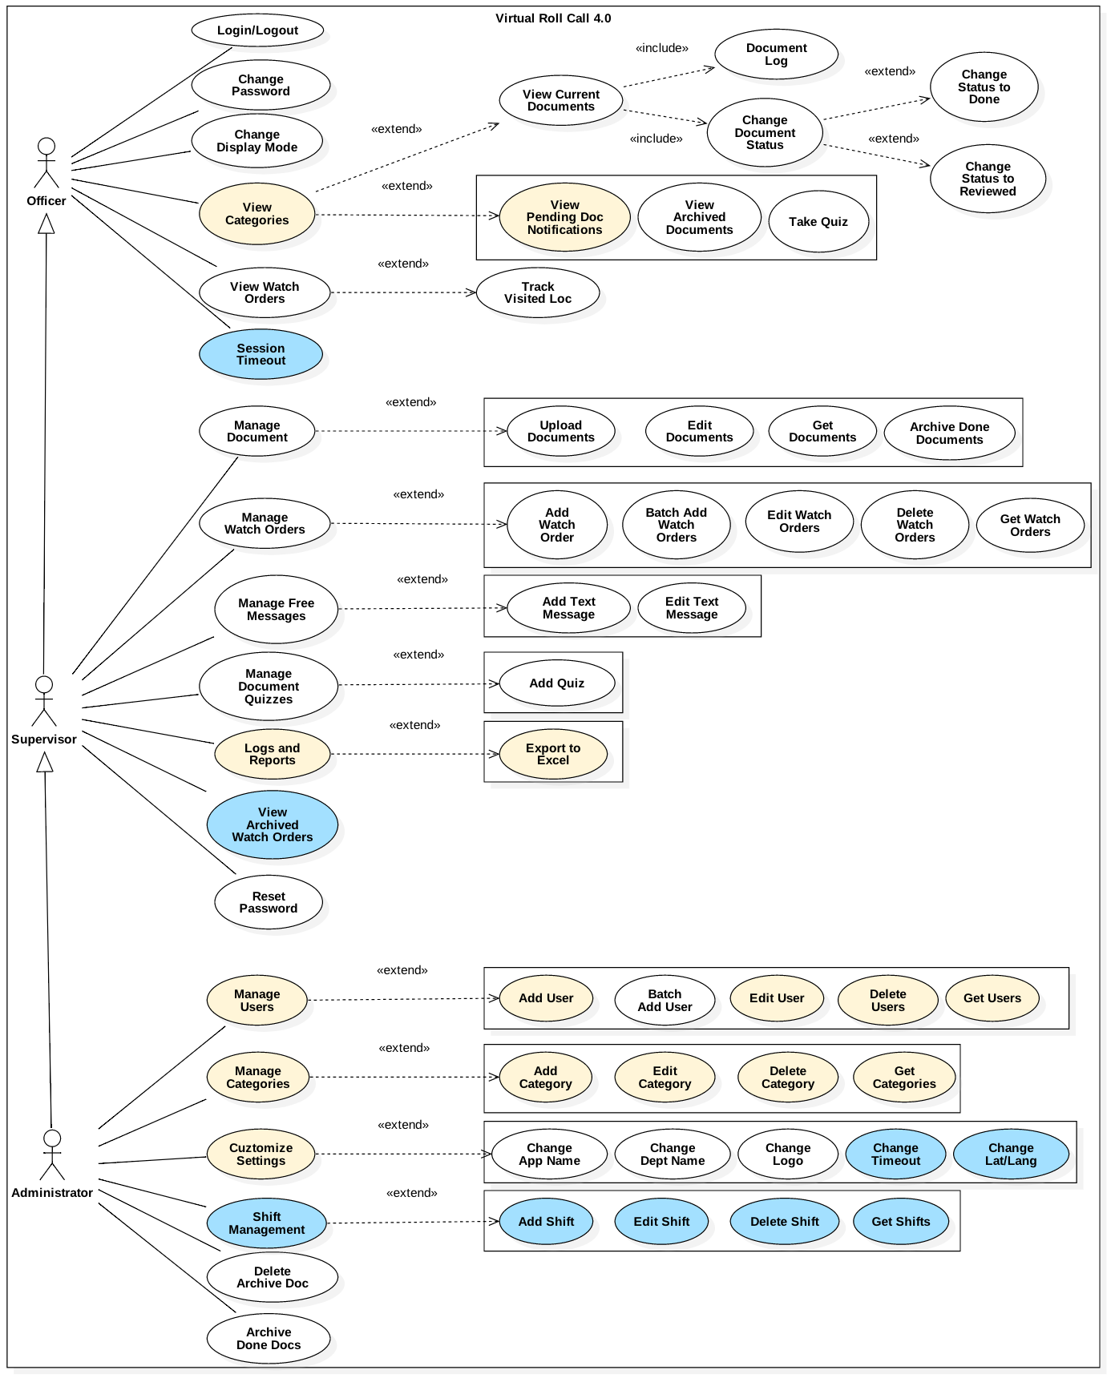
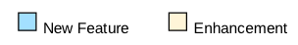
Requirements: Use Cases
Notes:
5 seconds
Show the Use Case Diagram for the whole project. Highlight your use cases.

Slide 5
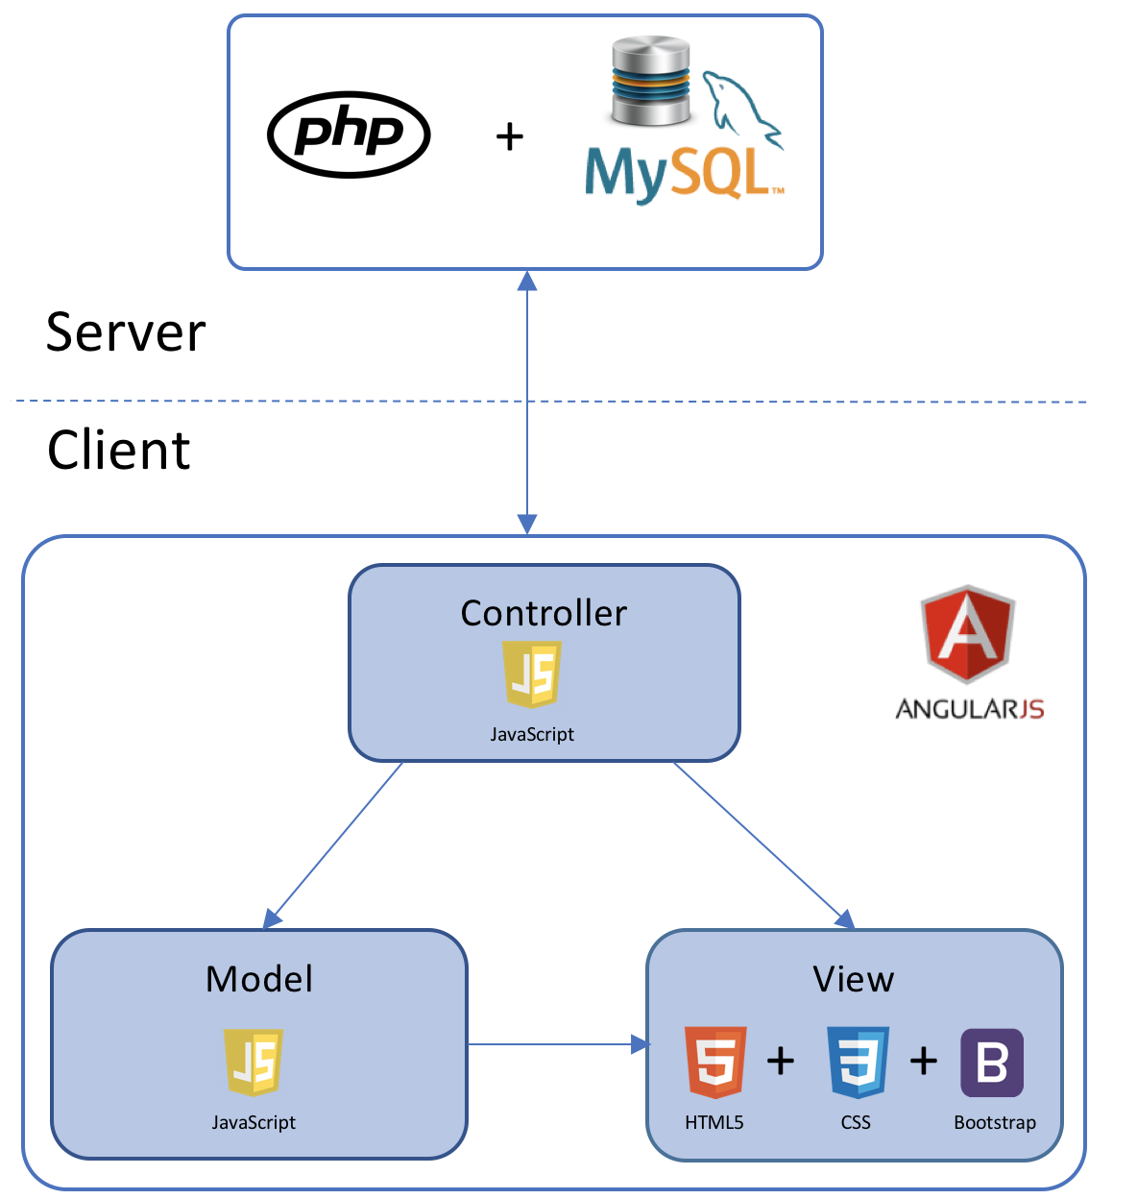
System Design: Architecture
Model-View Controller
Model-View-Controller is an architectural pattern commonly used for designing web applications. As the name implies, there are 3 major components in the architecture:
Model – Manages the data and logic of the application
View – The User Interface of the application
Controller – Receives user input and modifies data in the model
Client-Server Model
Our system uses the Client-Server model, which is an application structure used in distributed applications. The client makes requests to the server via the internet,and the server responds to the client with the requested function. Virtual Roll Call is hosted on a Windows Server, and clients are able to use the application and perform actions through the server.
Notes:
20 seconds
System design: Highlight the parts that you contributed to them.
1. System decomposition; identify the architecture patterns used
2. System deployment – h/w and s/w requirements

Slide 6
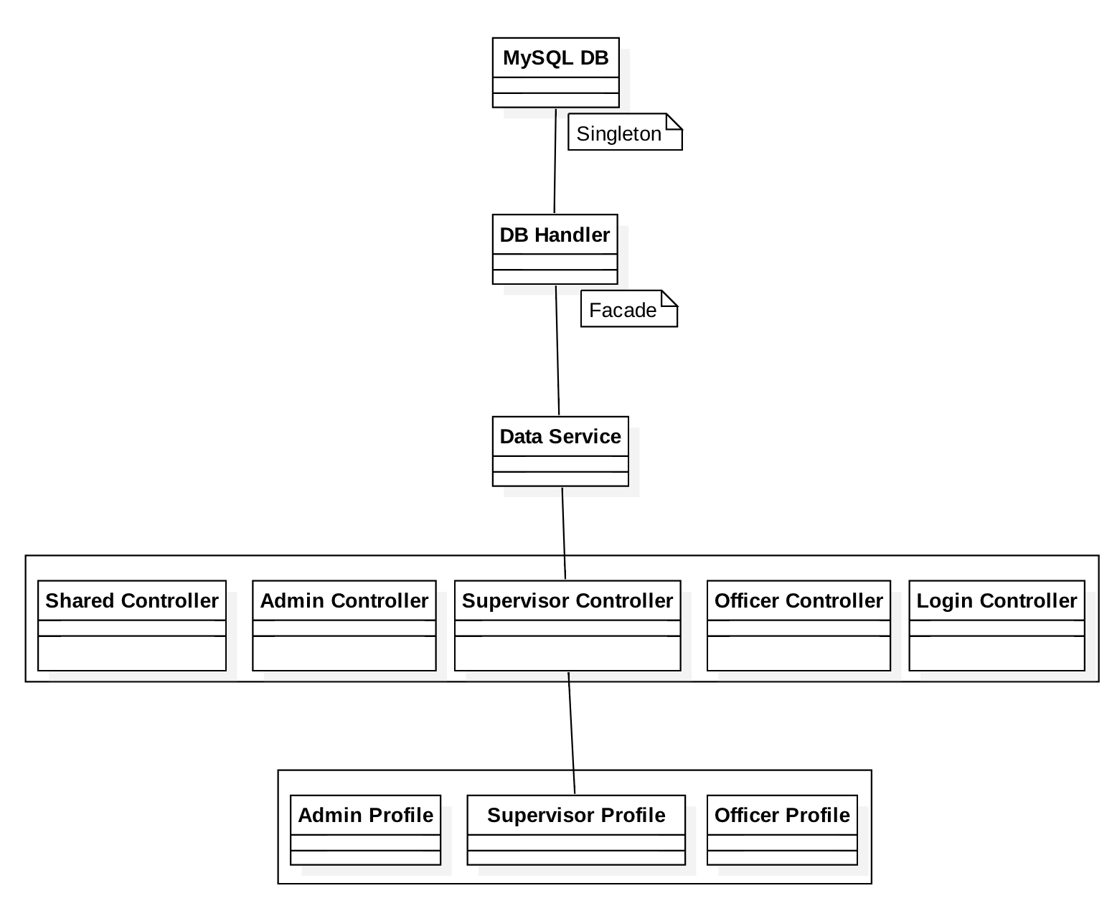
Minimal Class Diagram
Notes:
10 seconds.Minimal class diagram. Highlight the classes that you created/modified
Identify the design patterns used (one or more slides).

Slide 7
User Stories
User Story 332: Add Shift Functionality for Officers
User Story 343: Add Folder/Category Security Based on Officer’s Shift
User Story 347: Add Site Settings for Session Timeout
User Story 328: Automatically Logout User after Being Idle for Timeout Period
User Story 333: Show Pending Documents on Supervisor’s log
User Story 329: Archive Watch Order
User Story 311: Set Watch Order Map Default Position Based on Longitude and Latitude from Site Settings
Notes:
5 seconds.
List the user stories that you worked on them.(put in order of importance). Stay focused on the parts that you have been working.

Slide 8
User Story #332
Add Shift Functionality for Officers
As an administrator, I would like to assign officers to a specific shift in the system so I can restrict the access to certain areas of the application based on the officer’s shift.
Acceptance Criteria:
Shifts need to be setup before being assigned to the officers through the application settings.
Shifts can be updated/deleted at any time.
Officers must be assigned to a specific shift.
Administrators can change an officer’s shift at any time.
Notes:
60 seconds
The tile of user story
The most important user story you worked on it. You have to describe this one very well and be proud of that.
Please present and show the complexity of your work, code, algorithms, and technical challenges and technologies you have used. (you could use screenshot if you want. Visual presentations are better than text presentation)
Go into the details of the most important/significant tasks using bullet lists or visual graphs or state chart diagram
Sequence Diagram for this user story is mandatory (in another separate page if required)
Demo using screenshots or GIF (in another separate page if required)

Slide 9
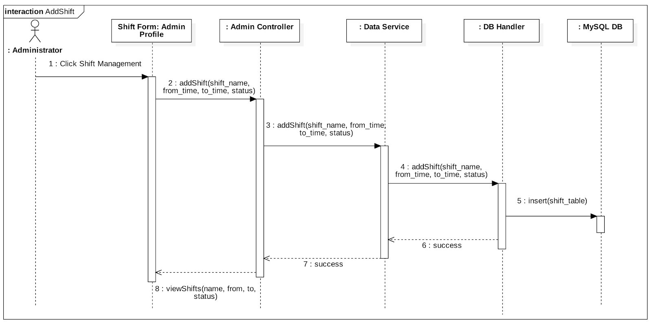

Slide 10
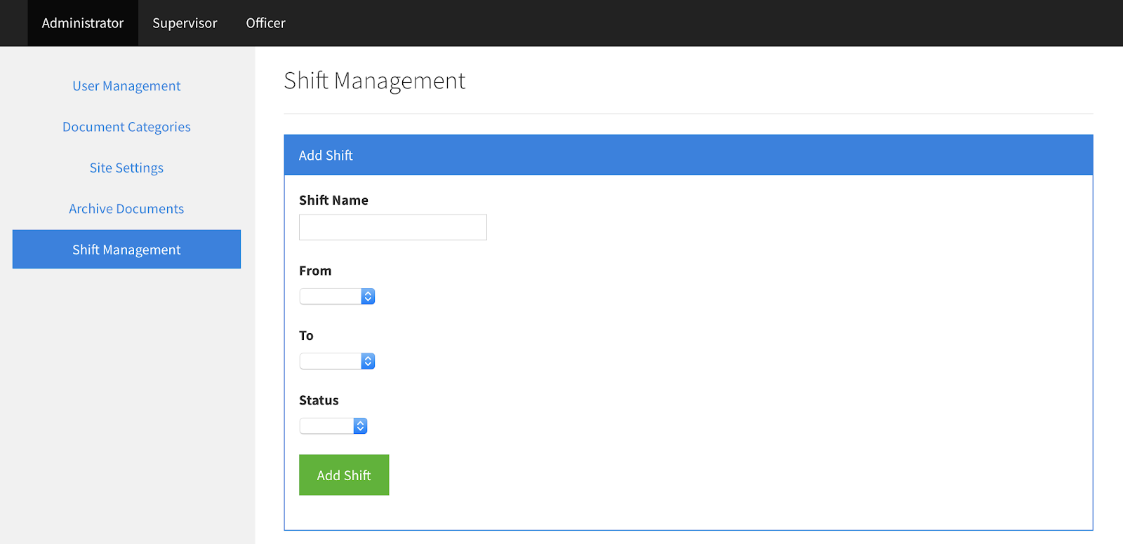

Slide 11
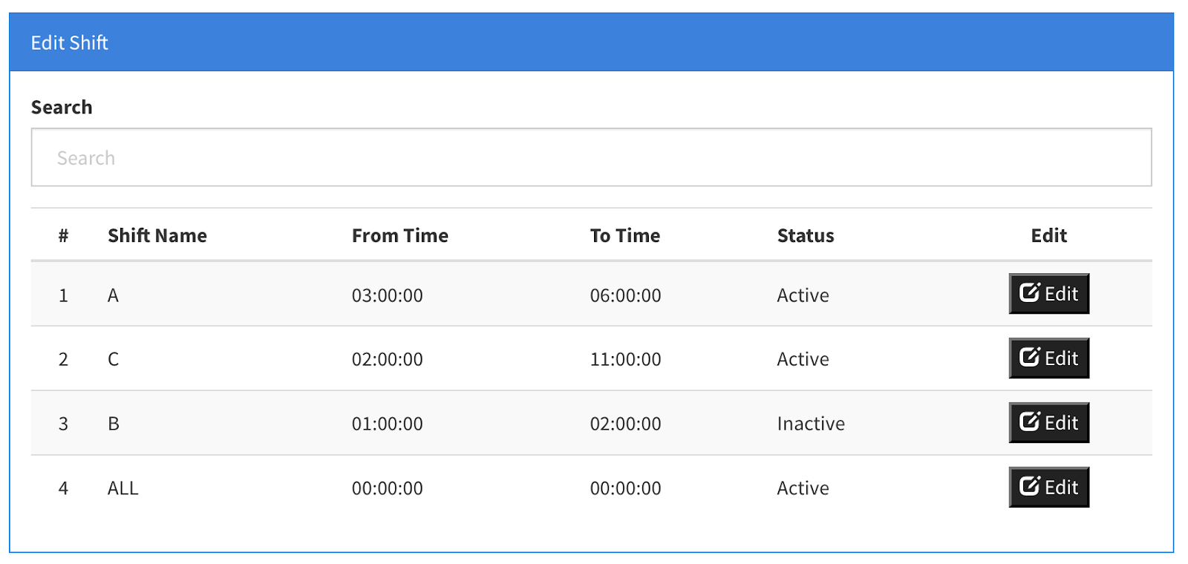

Slide 12
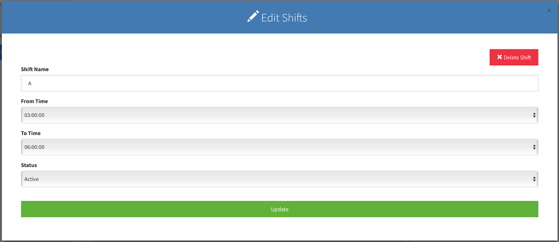

Slide 13
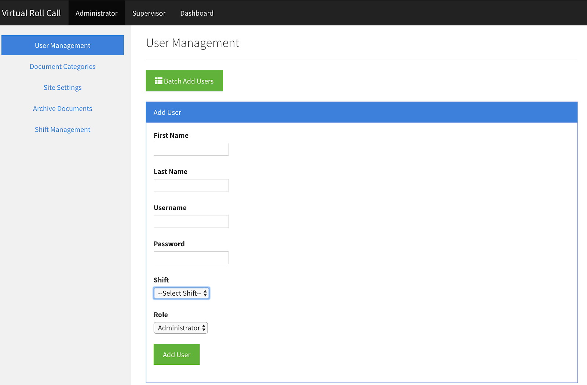

Slide 14
User Story #343
Add Folder/Category Security Based on Officer’s Shift
As an officer, I would like to only see folders that contain information for my current shift.
Acceptance Criteria:
Supervisors and Administrators can see all folders/categories.
Officers can only see folders for their current shift.
When supervisors create folders/categories, shift visibility must be assigned to the category.
Folder/category visibility can be setup for multiple shifts.
Category visibility can be updated at any time.
Notes:
20 seconds
The tile of user story
Please present and show the complexity of your work, code, algorithms, and technical challenges and technologies you have used. (you could use screenshot if you want. Visual presentations are better than text presentation) - Go into the details of the most important/significant tasks using bullet lists or visual graphs or state chart diagram - Demo using screenshots or GIF (in another separate page if required)
Sequence Diagram for this user story is optional

Slide 15
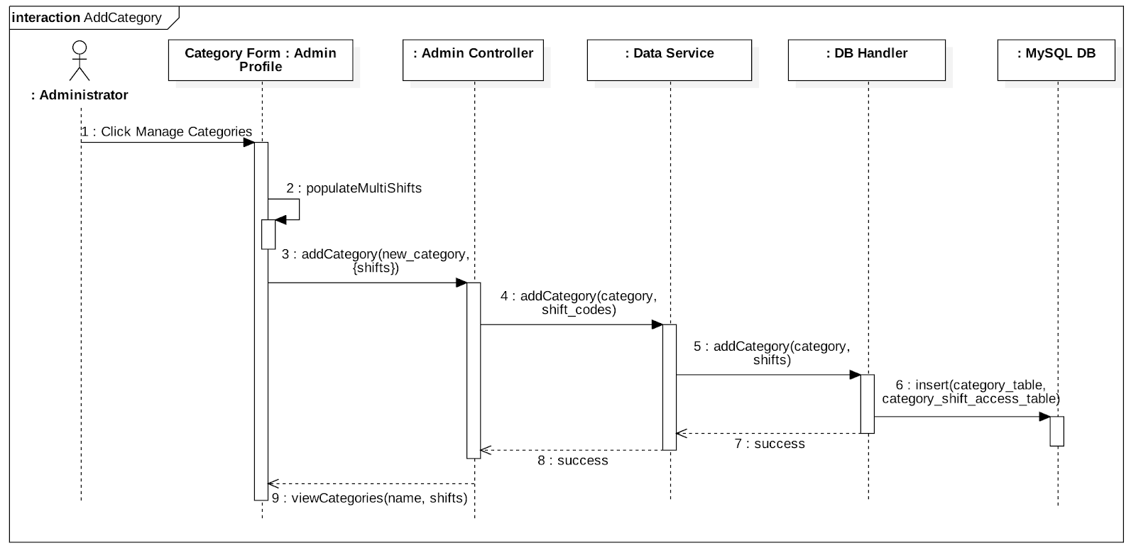

Slide 16
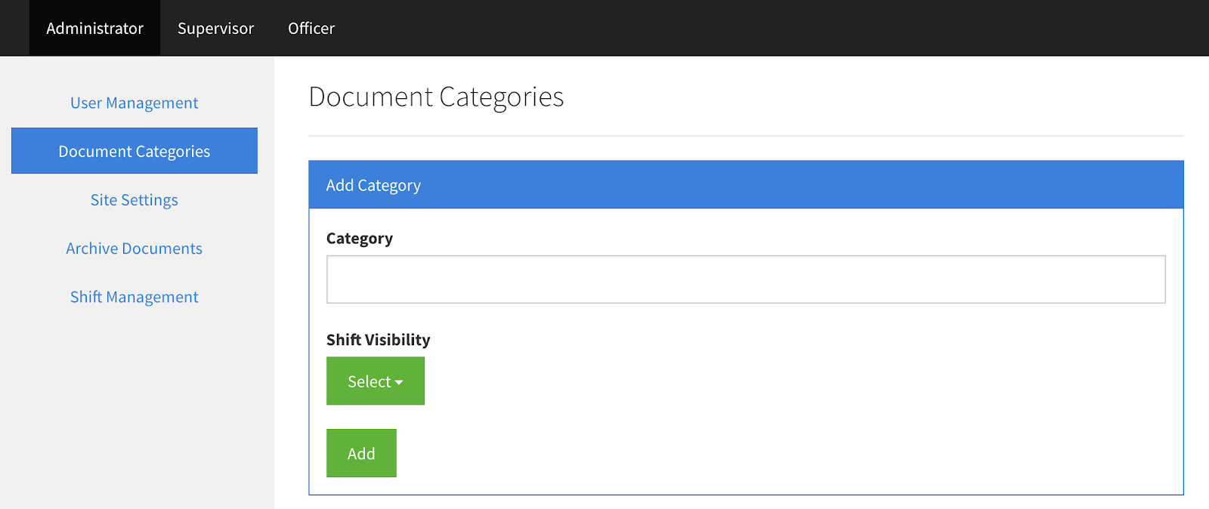

Slide 17
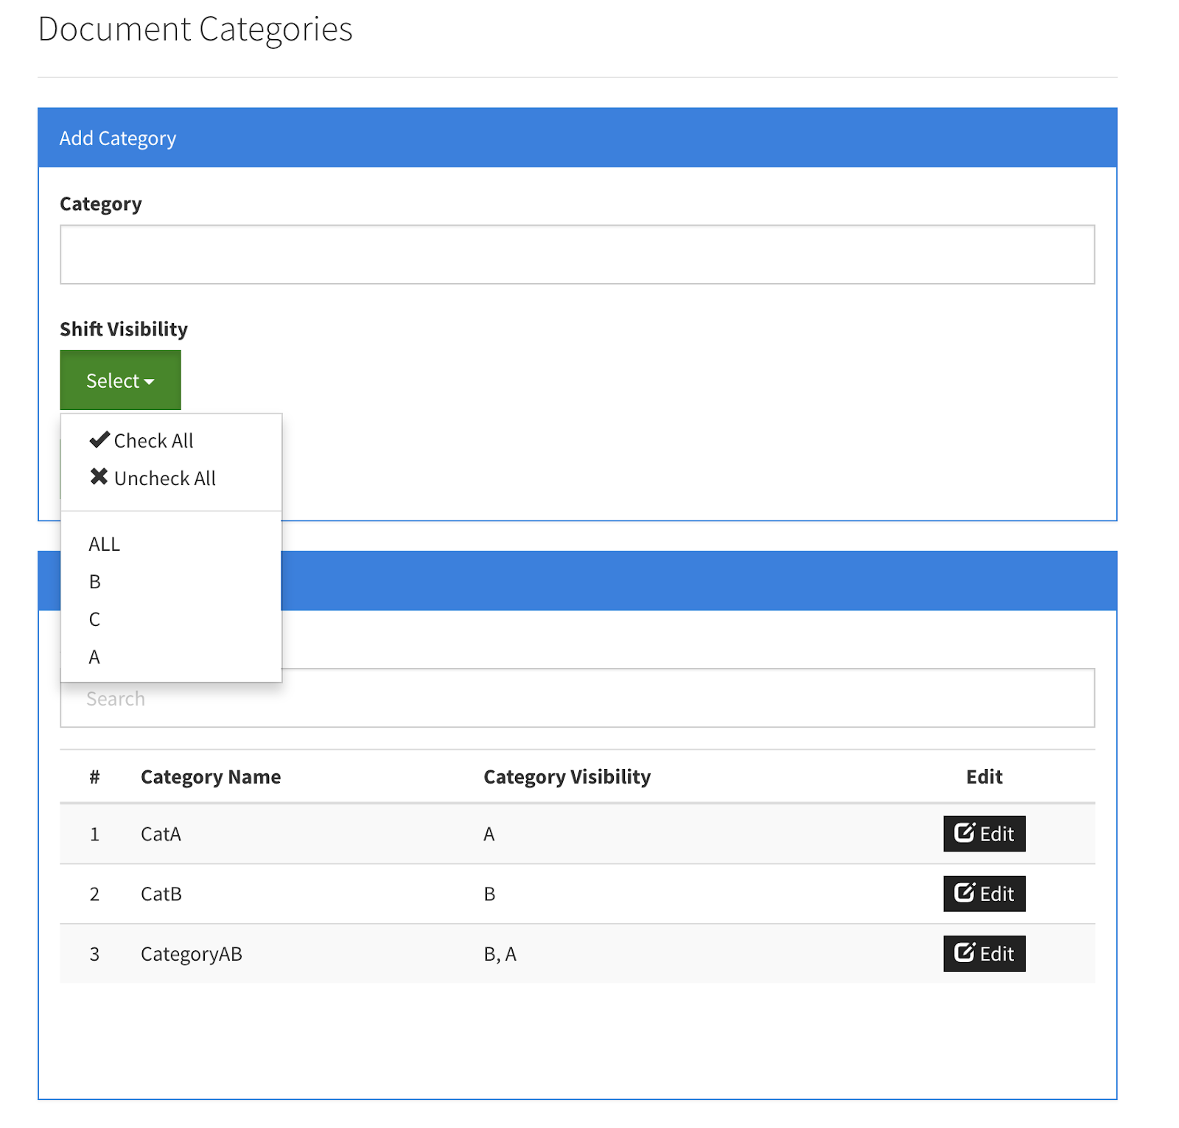

Slide 18
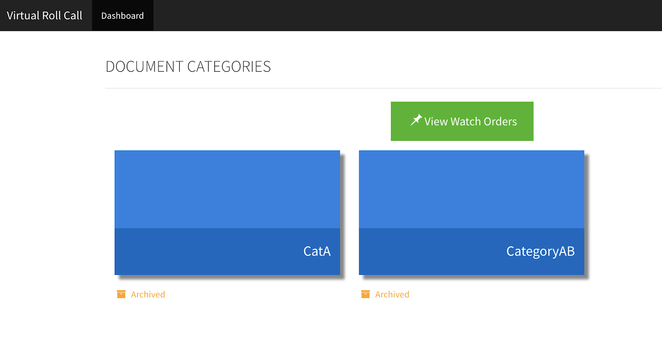

Slide 19
User Story #347
Add Site Settings for Session Timeout
As an administrator, I would like to control the timeout period so that users are kicked out of the system if there are idle for such time.
Acceptance Criteria:
Add section to Site Settings to enter the timeout period in minutes.
This section is only controlled by Administrators.
Users that are idle for the number of minutes in that setting should be logged out of the system.
Notes:
20 seconds
The tile of user story
Please present and show the complexity of your work, code, algorithms, and technical challenges and technologies you have used. (you could use screenshot if you want. Visual presentations are better than text presentation) - Go into the details of the most important/significant tasks using bullet lists or visual graphs or state chart diagram - Demo using screenshots or GIF (in another separate page if required)
Sequence Diagram for this user story is optional

Slide 20
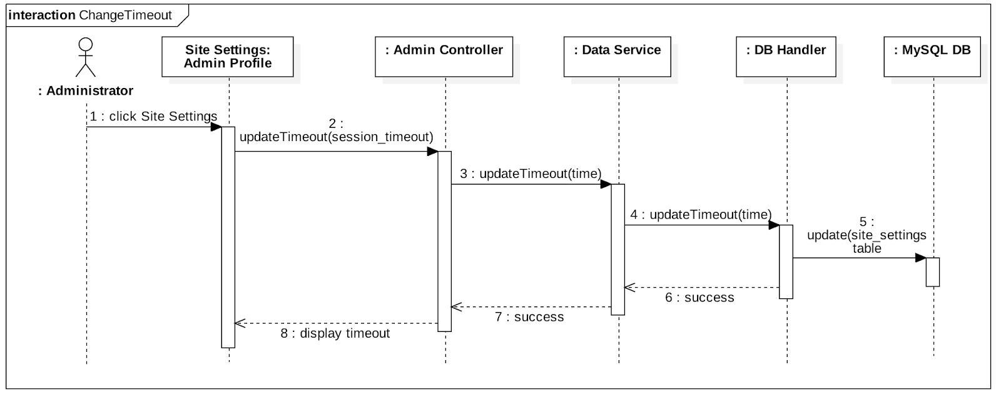
Notes:
20 seconds
The tile of user story
Please present and show the complexity of your work, code, algorithms, and technical challenges and technologies you have used. (you could use screenshot if you want. Visual presentations are better than text presentation) - Go into the details of the most important/significant tasks using bullet lists or visual graphs or state chart diagram - Demo using screenshots or GIF (in another separate page if required)
Sequence Diagram for this user story is optional

Slide 21
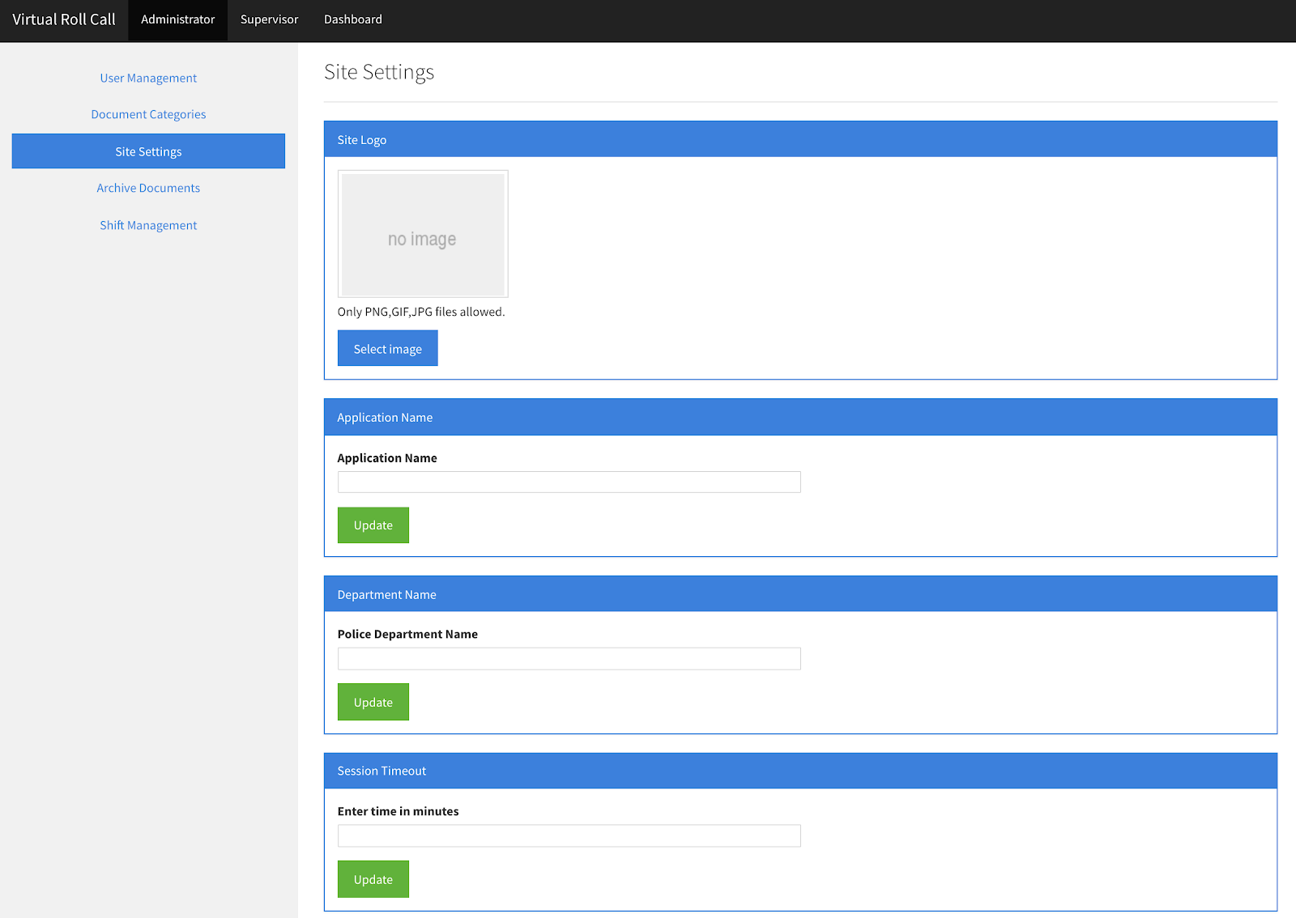

Slide 22
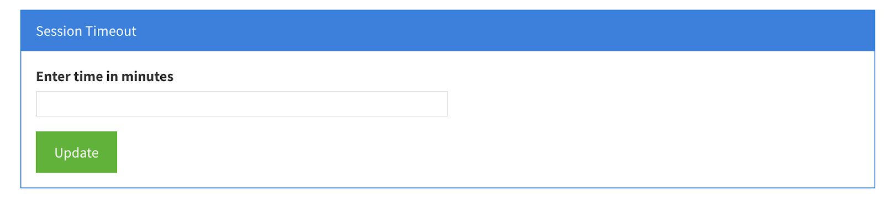
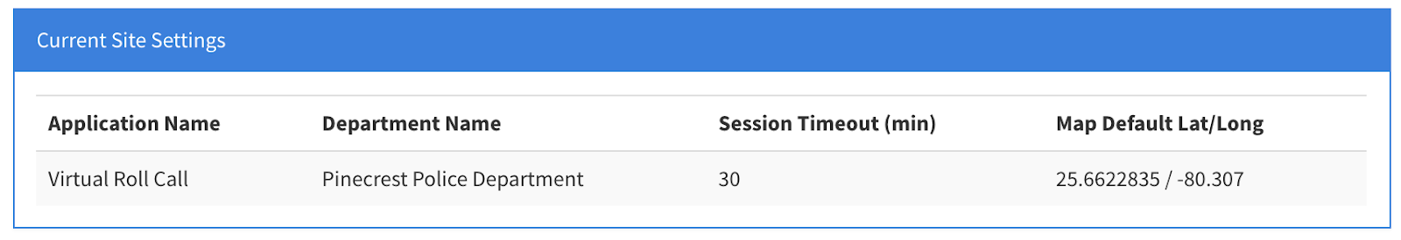

Slide 23
User Story #328
Automatically Logout User after Being Idle for Timeout Period
As a user, I would like to be logged out after being idle for timeout period so that my account is protected.
Acceptance Criteria:
After being idle for timeout period, show pop-up window advising the user that the section will be closed if they don’t take action.
User should be able to move the mouse and continue working on site to prevent section from closing.
Pop-up will display on screen for 60 seconds. If user does not take action, the section will terminate.
Notes:
20 seconds
The tile of user story
Please present and show the complexity of your work, code, algorithms, and technical challenges and technologies you have used. (you could use screenshot if you want. Visual presentations are better than text presentation) - Go into the details of the most important/significant tasks using bullet lists or visual graphs or state chart diagram - Demo using screenshots or GIF (in another separate page if required)
Sequence Diagram for this user story is optional

Slide 24
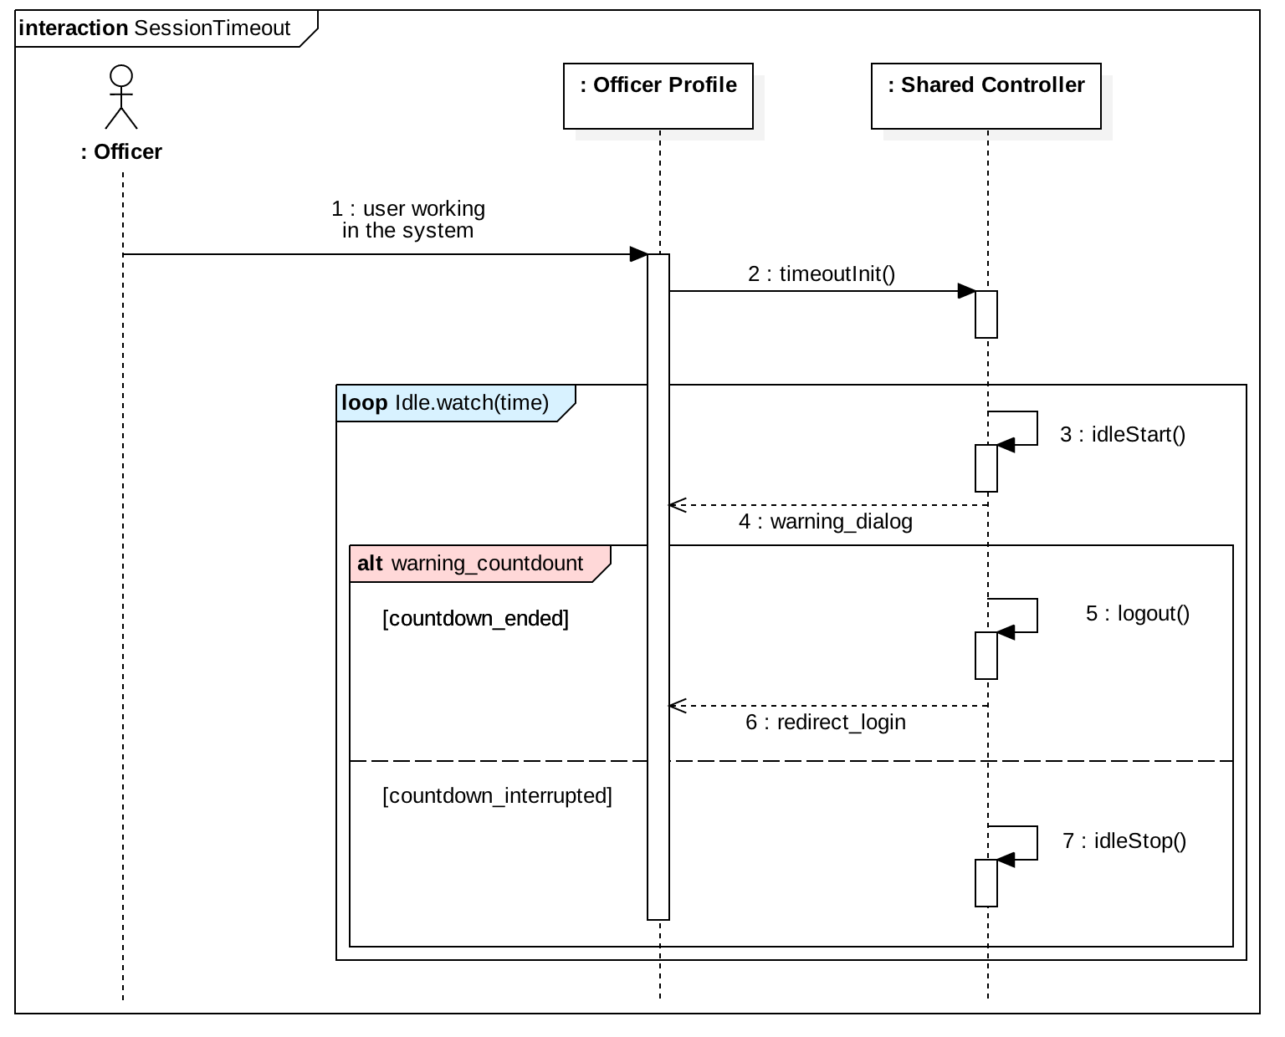

Slide 25
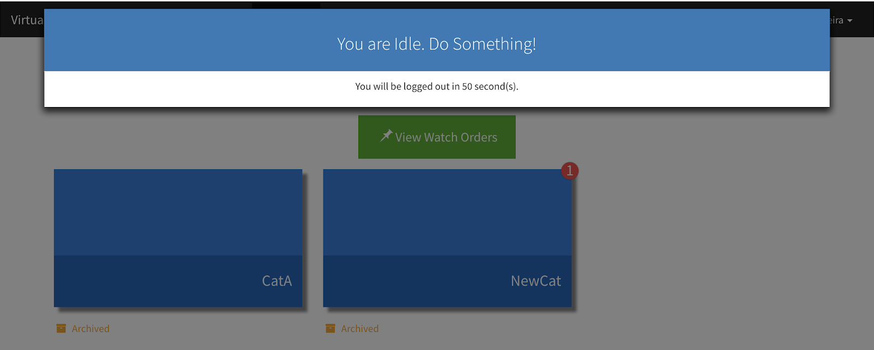
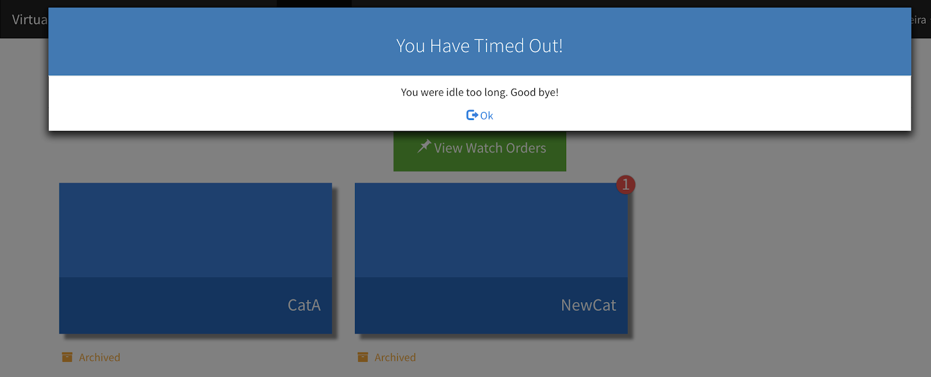

Slide 26
User Story #333
Show Pending Documents on Supervisor’s log
As a supervisor, I would like that pending documents are displayed in my log so that I can keep track of who has not reviewed certain documents.
Acceptance Criteria:
Display pending documents in the supervisor’s log.
Display should follow the same format as reviewed ad done documents that are currently displayed.

Slide 27
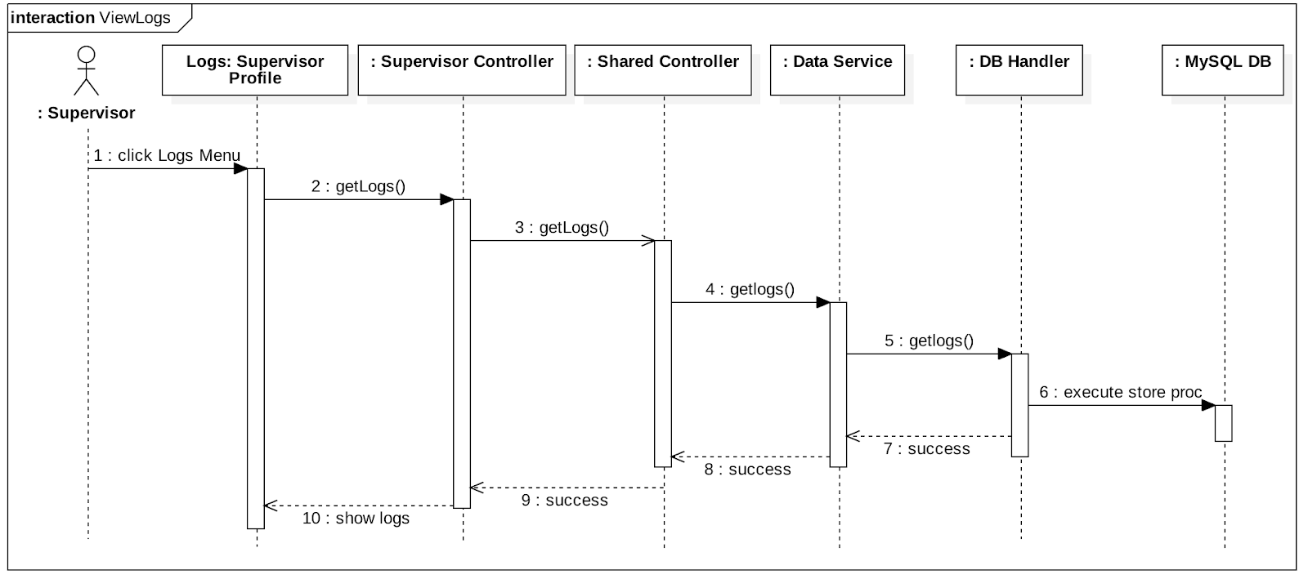

Slide 28
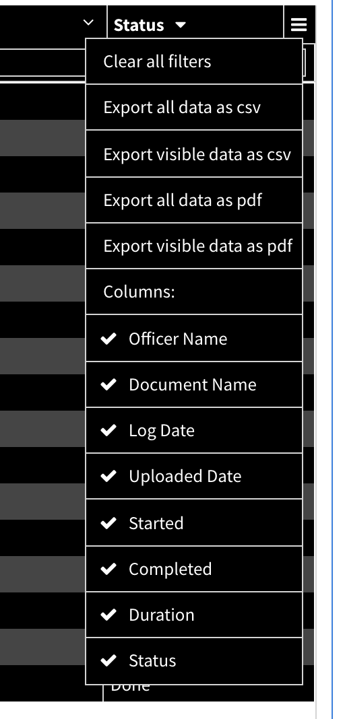
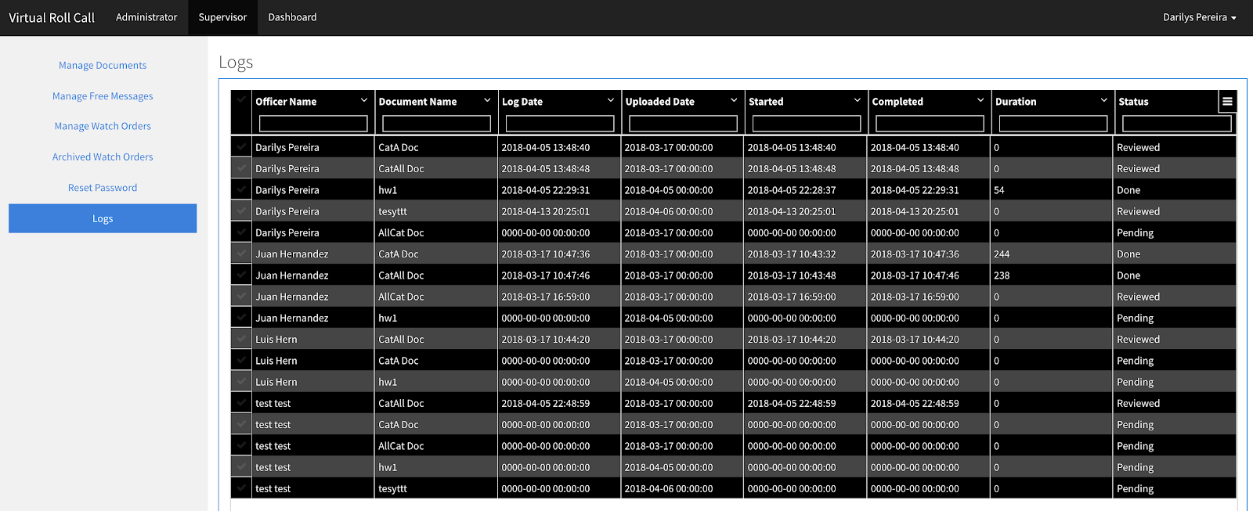

Slide 29
User Story #329
Archive Watch Orders
As an administrator, I would like that watch orders which expiration date is in the past are archived so that we keep historical records of all watch orders.
Acceptance Criteria:
Archive Watch Orders by Expiration Date
Admins and supervisors can see the archived watch orders in a new tab under logs in supervisor.
Display relevant fields in a grid.

Slide 30
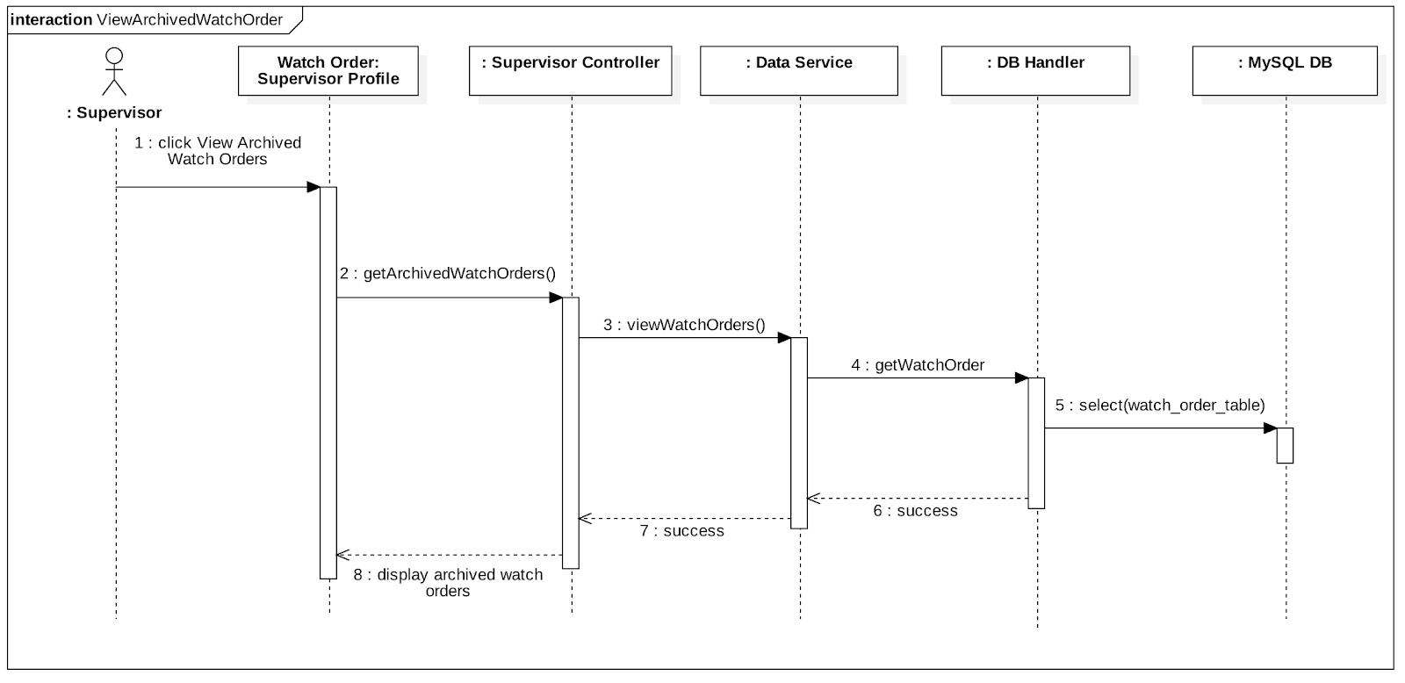

Slide 31
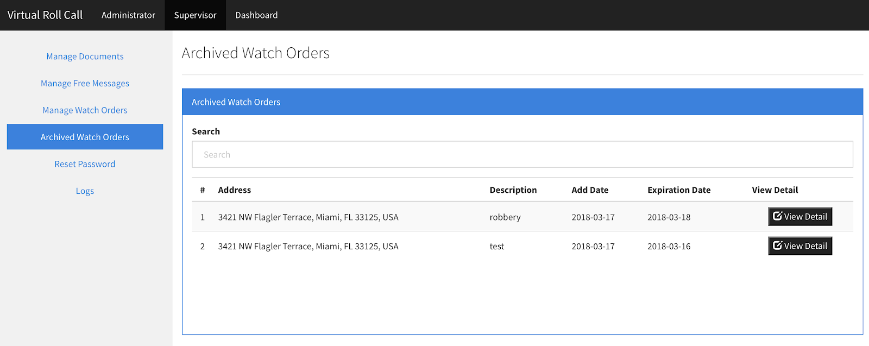

Slide 32
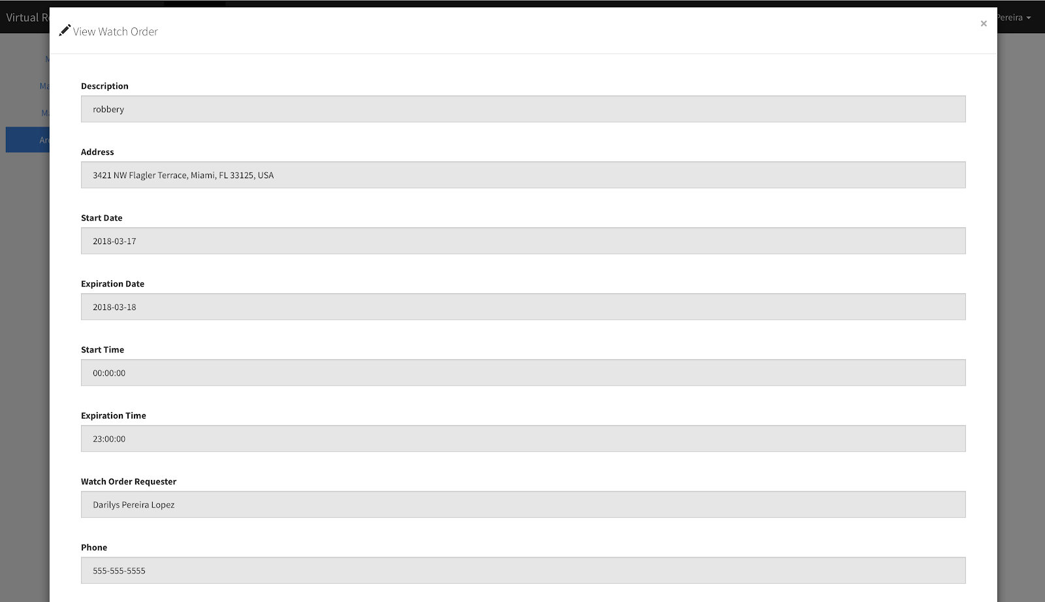

Slide 33
User Story #311
Set Watch Order Map Default Position Based on Longitude and Latitude from Site Settings
As an officer, I would like to track the locations I visited so it can help me identify the locations I haven’t been at.
Acceptance Criteria:
Provide the ability to the officer to mark and unmarked locations in the View Watch Order screen grid.
Provide a button to unmark all.
Save changes so that when officer logs out and logs back in, his/her locations are marked as them left them.

Slide 34
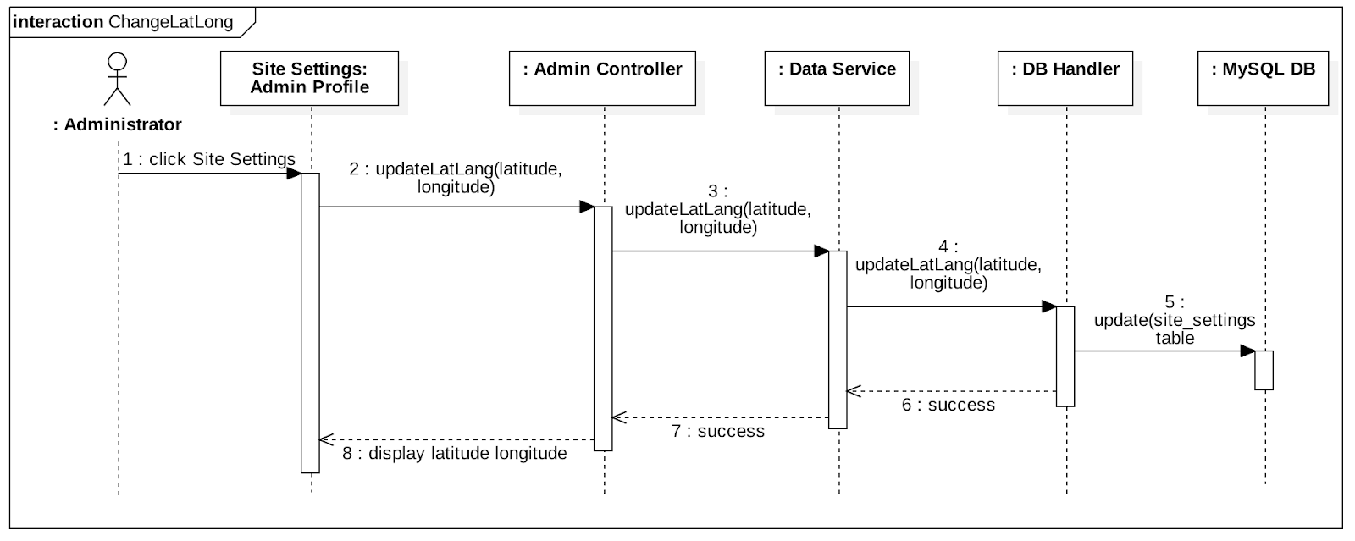

Slide 35
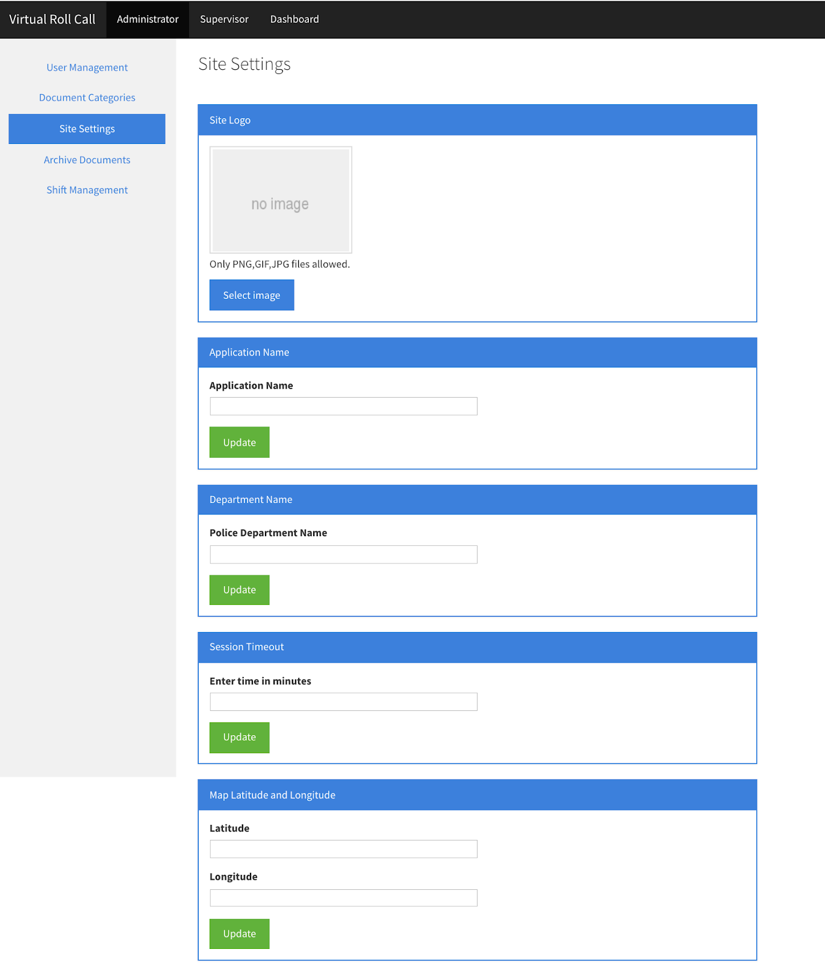

Slide 36
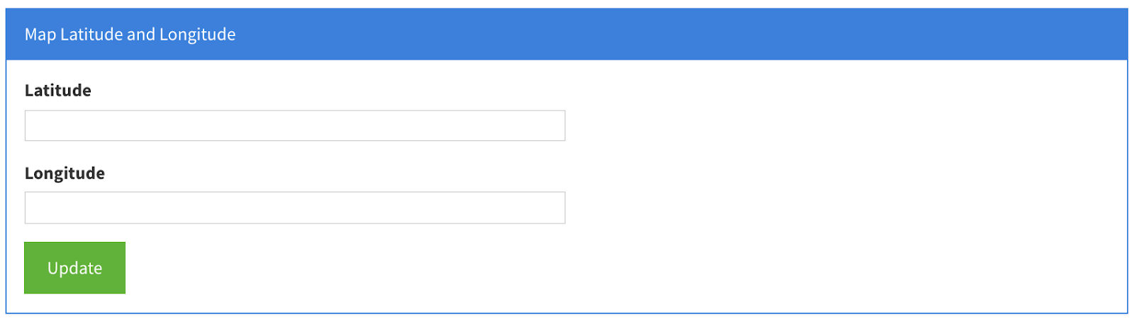

Slide 37
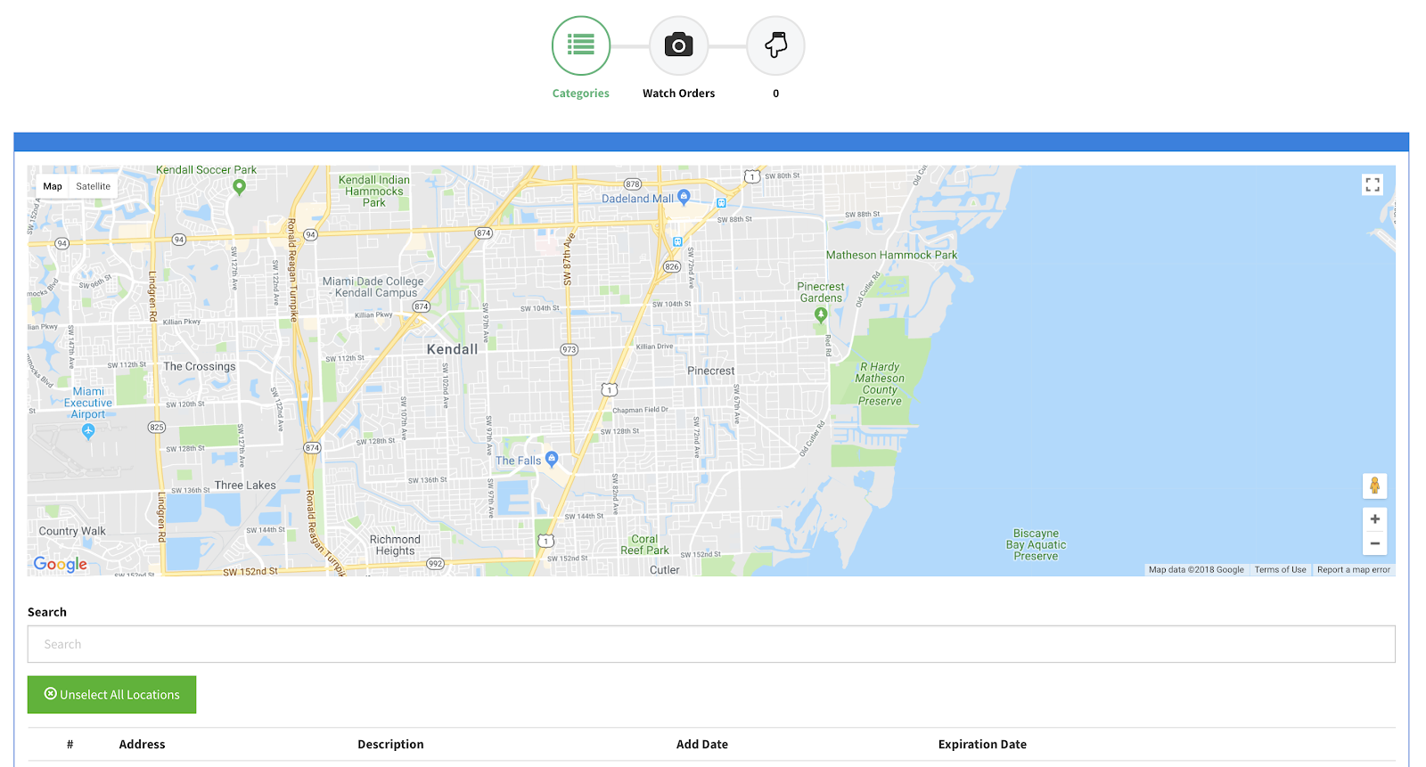

Slide 38
Test Suites and Test Cases
Test Case ID | User Story 332: Add Shift Functionality for Officers-U1
Purpose | Verify a new shift is added to the database when user attempts to create it using the user interface.
Preconditions | User is logged in. User is in Shift Management Page
Input | User enters the shift information: shift name, form, to, status User clicks the ‘Add Shift’ button.
Expected Output | New shift is created in the database and automatically displayed in the Edit Shift section.
Actual Output | New shift is successfully saved in the database and populated in the Edit Shift section of the Shift Management page.
Status | Pass
Notes:
10 seconds
A description of verification process and Test Suites and Test Cases for one of the use cases.
1 One sunny day and one rainy day for the implemented use cases (one or more slides).
2 Automated test scripts for the implemented use cases (if any) (one or more slides).

Slide 39
Test Suites and Test Cases
Test Case ID | User Story 332: Add Shift Functionality for Officers-U2
Purpose | Verify a new shift can’t be added without specifying the shift name, from, to, and status fields.
Preconditions | User is logged in. User is in Shift Management Page
Input | User enters the shift information: shift name, form, to, status User clicks the ‘Add Shift’ button.
Expected Output | If user leaves any of the input fields empty a message should be displayed advising shift wasn’t added.
Actual Output | Warning message was displayed to the user when one of the fields was not populated. Shift was not created in the database.
Status | Pass

Slide 40

Summary
Enhanced view document feature by creating visibility layer based in shifts.
Improved system security by enforcing session timeout.
Added flexibility to control system settings like map position and timeout period.
Flexible supervisor reporting.
Darilys Pereira Lopez
Questions?
Thank You!
Notes:
10 seconds
Summarize your contribution, mention your effort for Scrum, Mingle, Github, Google Drive Documentation and minutes
Include your contact information
Ask if anyone has any questions for you.
Thank your audience

